Slide 1
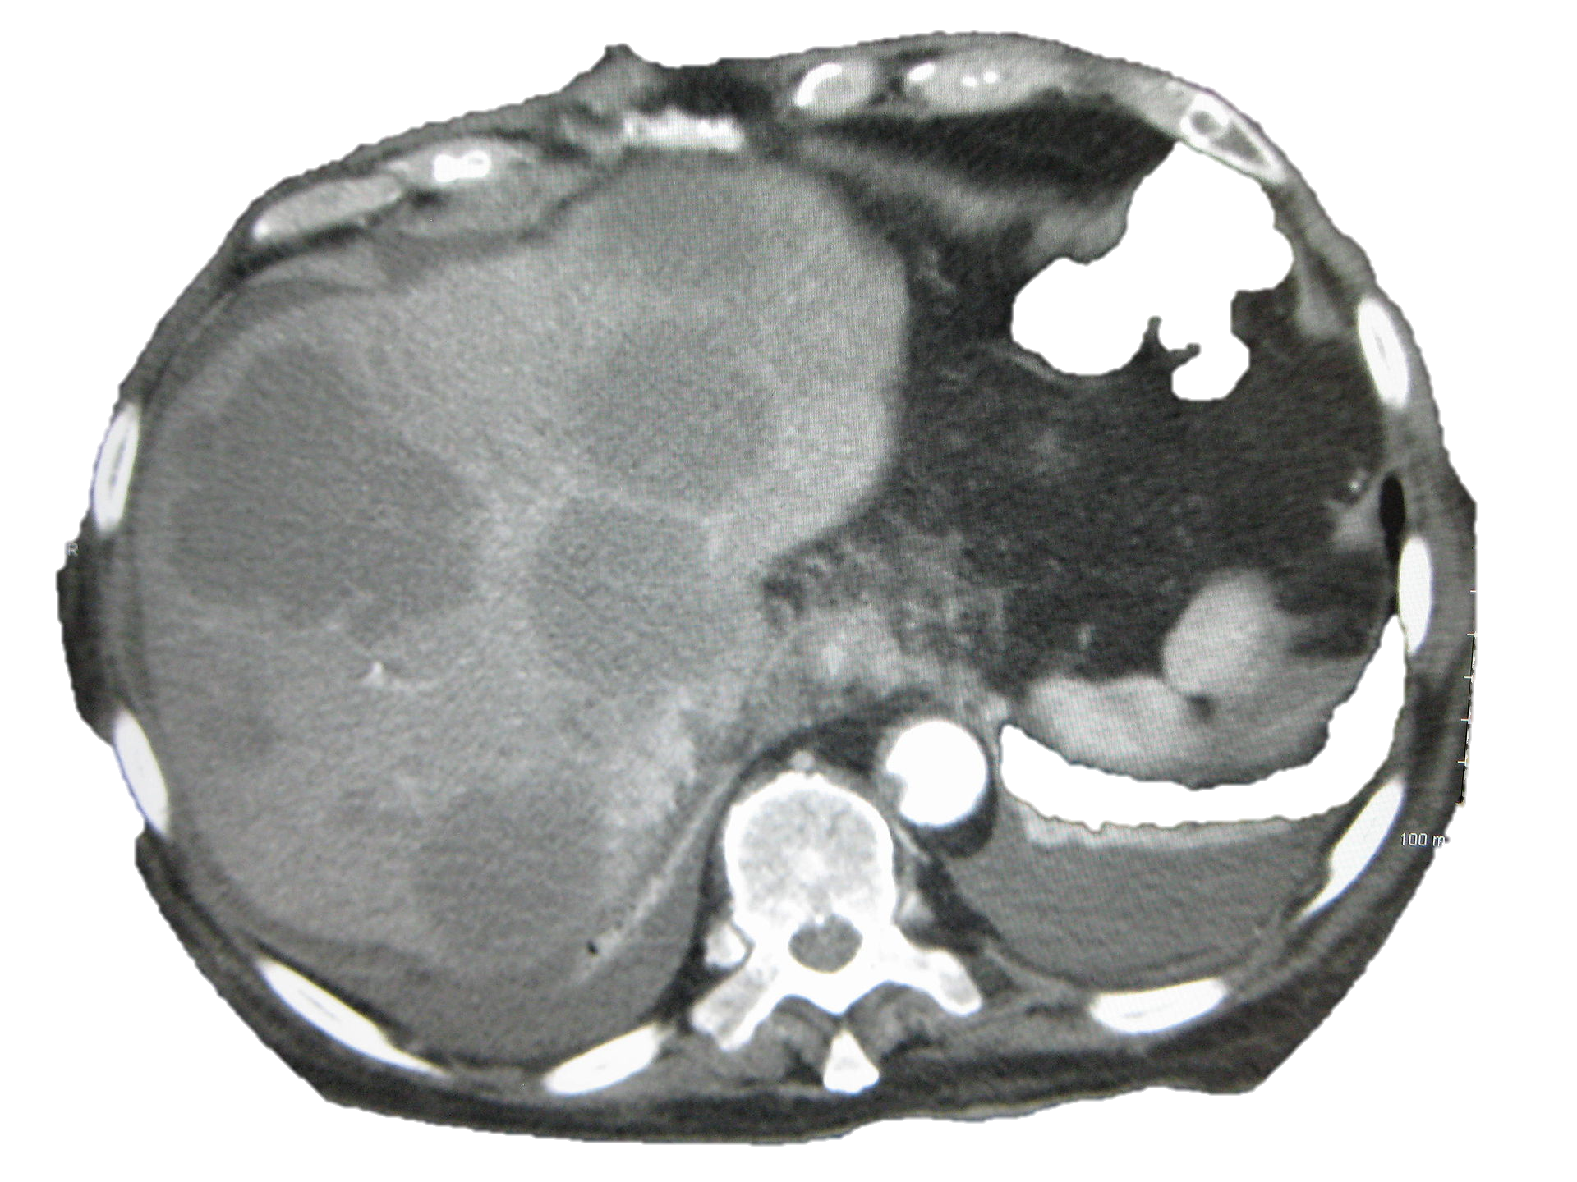



Empiric versus Site-Directed Chemotherapy
in Cancer of Unknown Primary
Alwin Krämer
Clinical Cooperation Unit
Molecular Hematology/Oncology
German Cancer Research Center and
Dept. of Internal Medicine V, University of Heidelberg

Slide 2
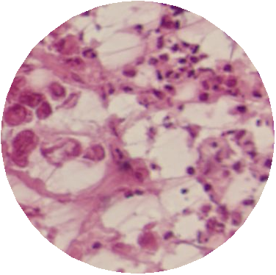
Tissue of Origin Testing
Similarity Scores
Colorectal | 88.2
Pancreas | 4.4
NSCLCC | 2.3
Breast | 2.1
Gastric | 1.2
Kidney | 0.6
Hepatocellular | 0.3
Ovarian | 0.3
Soft Tissue Sarcoma | 0.1
NHL | 0.1
Thyroid | 0.1
Prostate | 0.1
Melanoma | 0.1
Bladder | 0.1
GCT | 0.0
Core premise:
Different tissue types have distinct mRNA profiles
Uncertain specimen RNA profile generated
>1,500 genes
RNA profile compared with known tissue profiles

Slide 3
Gene Expression Profiling in CUP
Accuracy of Tissue of Origin Testing

Slide 4
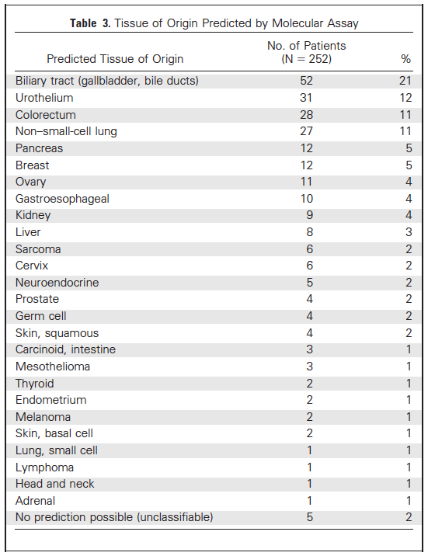
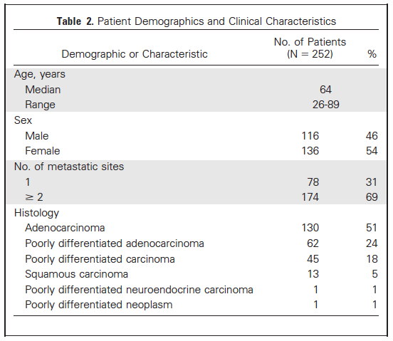
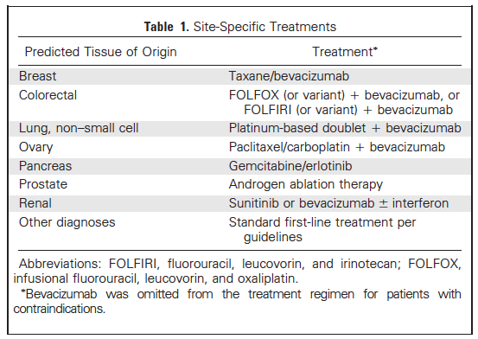
Gene Expression Profiling to Predict the Tissue of Origin
and Direct Site-specific Therapy in CUP Patients
Hainsworth et al., J Clin Oncol 31: 217-223, 2013

Slide 5
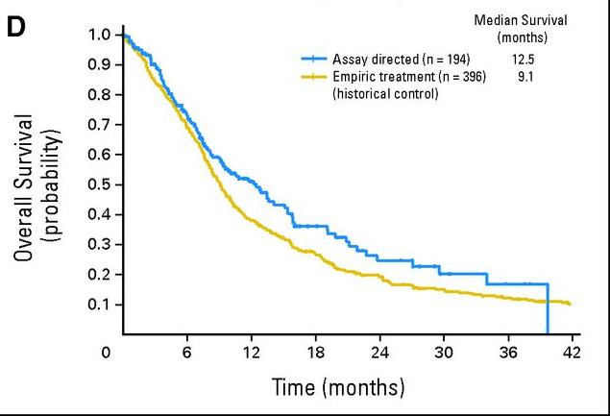
Gene Expression Profiling to Predict the Tissue of Origin
and Direct Site-specific Therapy in CUP Patients
Overall Survival
Hainsworth et al., J Clin Oncol 31: 217-223, 2013

Slide 6
GEFCAPI 04
Control arm: Empiric chemotherapy
(Cisplatin-Gemcitabine)
CUP
R
Personalized
treatment
Tissue Of Origin® Test
Phase III
n= 202 pts (HR=0,62 for PFS)
Pathwork to provide the TOO test
BioTheranostics (Biomerieux): Cancer Type ID® (= CUP-Print)
Standardized 92 gene RT-PCR assay
Requires 300-500 non-necrotic cancer cells
Sensitivity: 85%, Specificity: >99%
Courtesy of Karim Fizazi

Slide 7
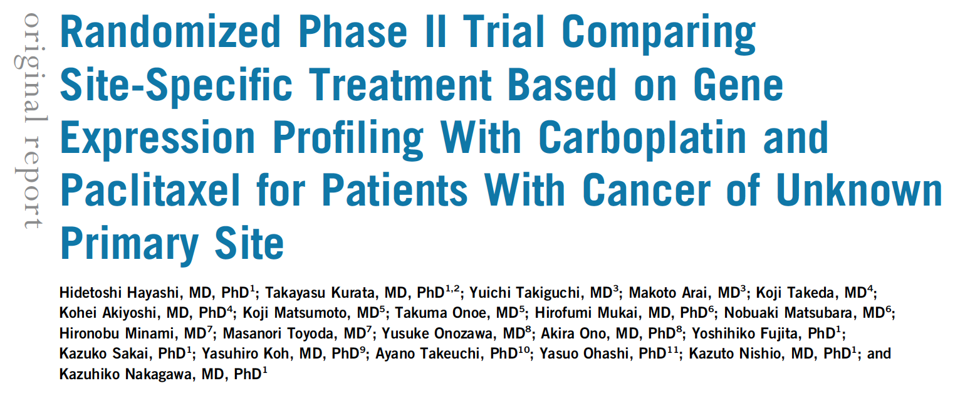
Japanese Trial
Hayashi et al., J Clin Oncol 2019

Slide 8
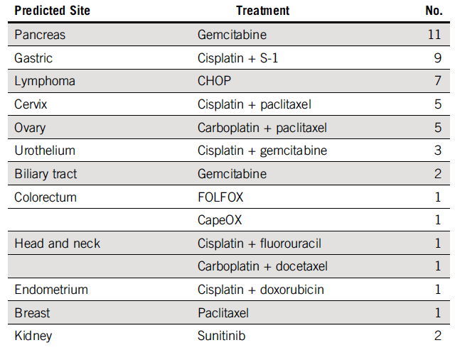

CONSORT Diagram
Site-specific treatment
Hayashi et al., J Clin Oncol 2019

Slide 9
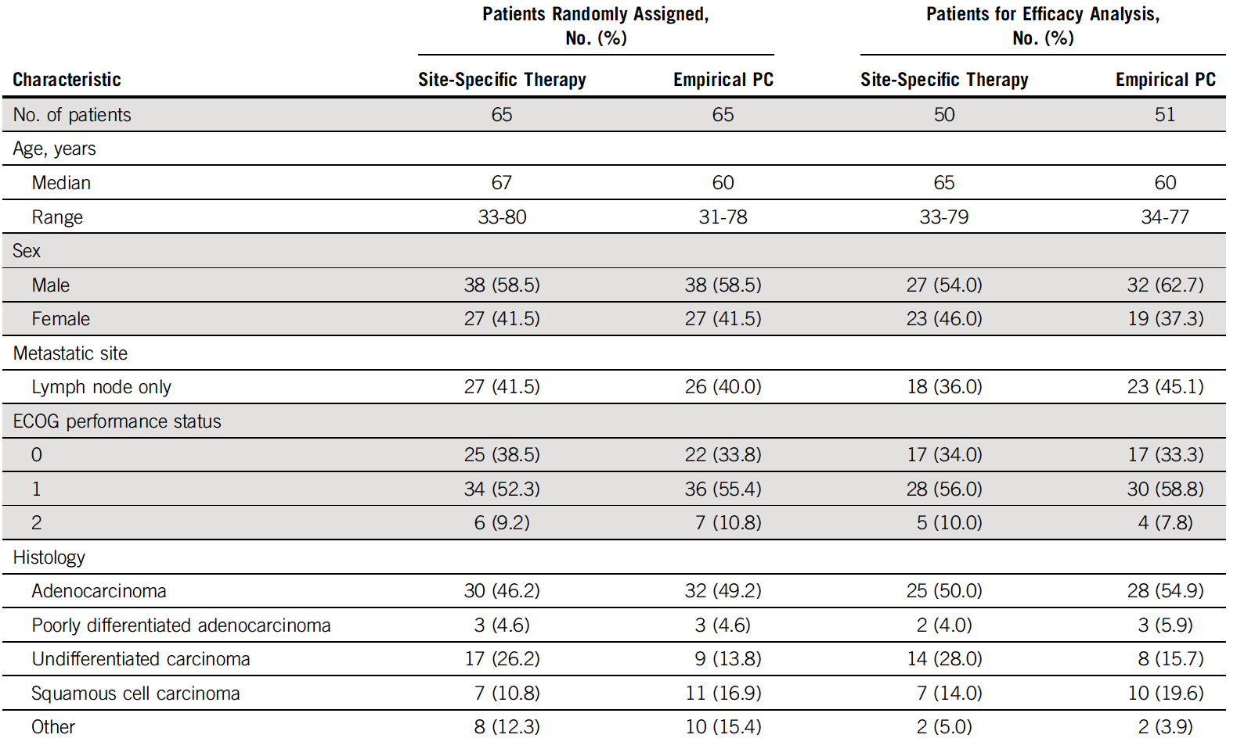
Patient Characteristics
Hayashi et al., J Clin Oncol 2019

Slide 10
Results for Site Prediction
Hayashi et al., J Clin Oncol 2019

