Slide 1
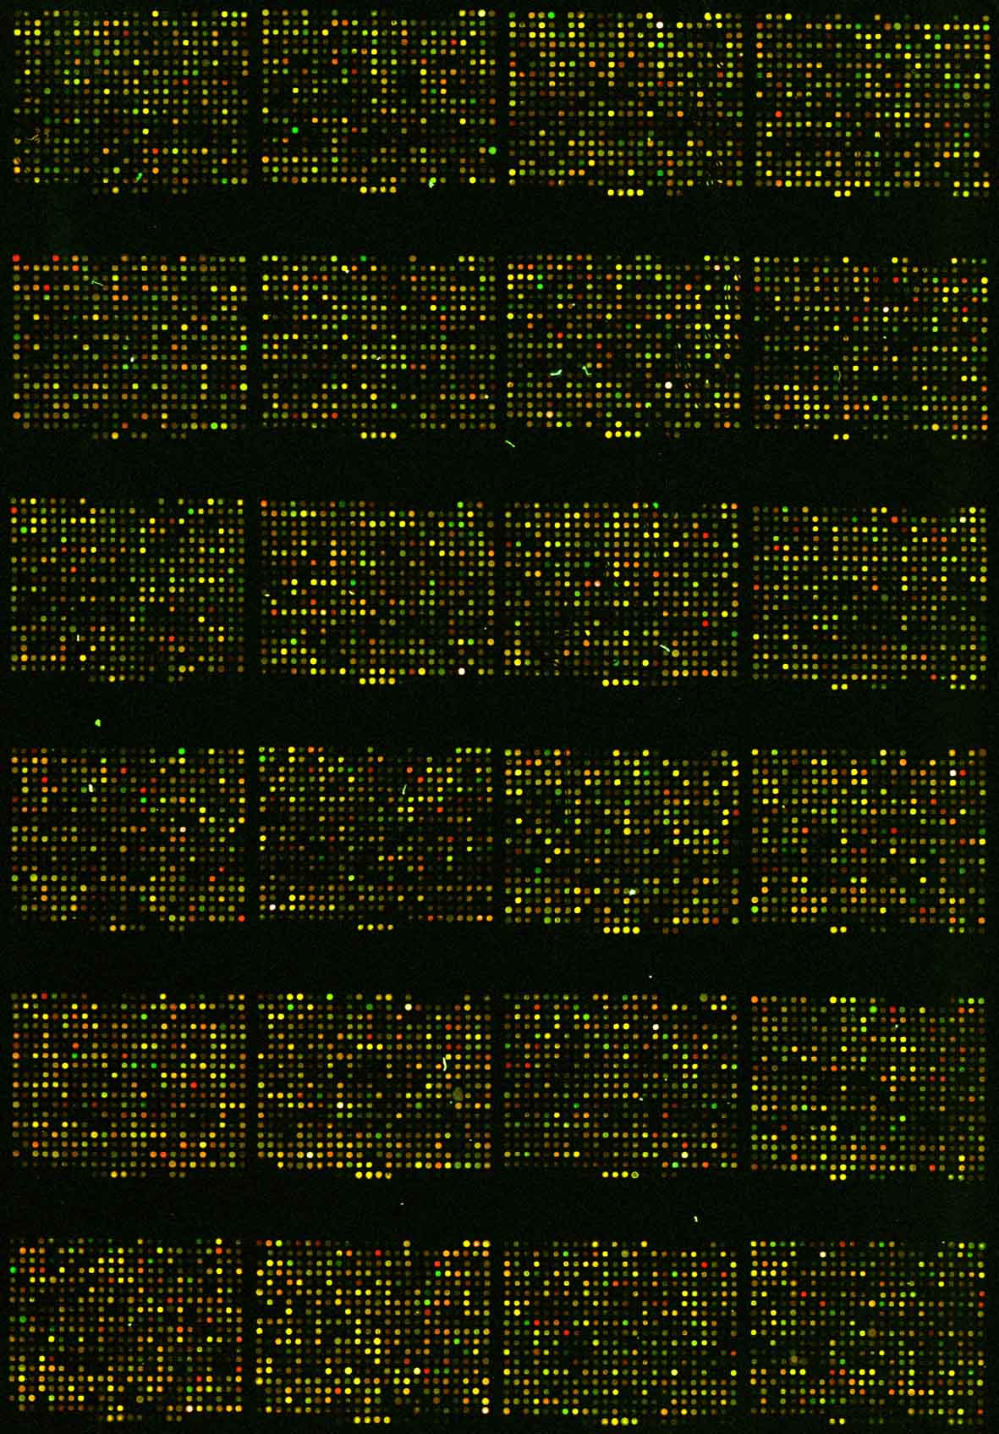
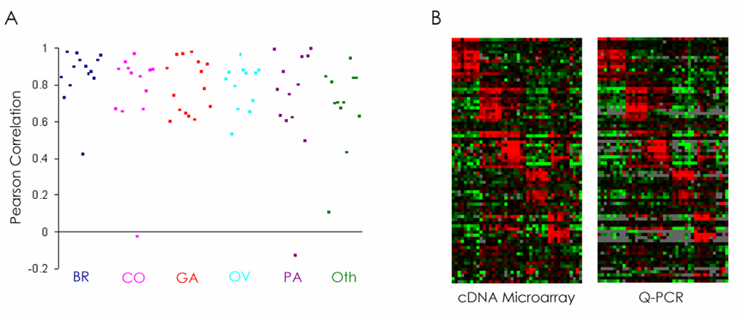
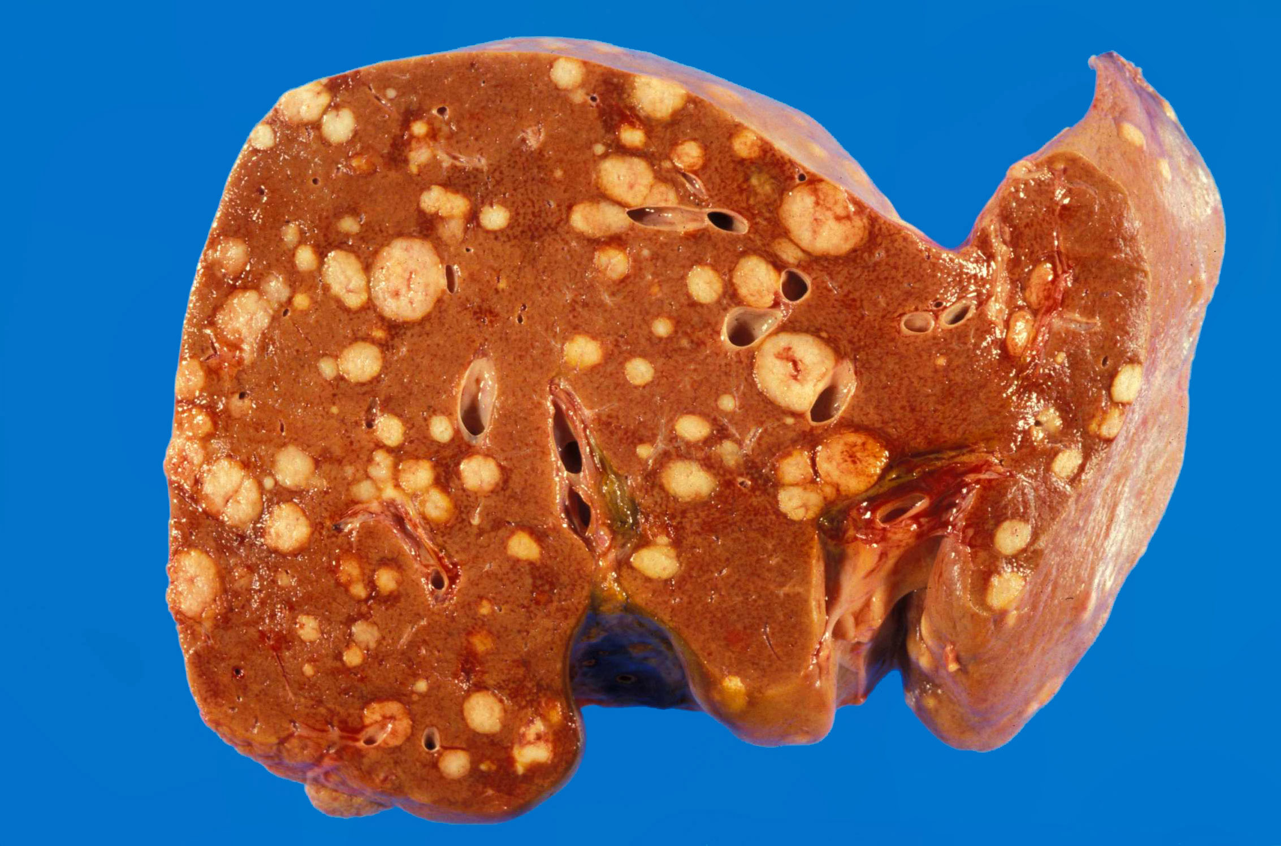
UK clinical trials Update 2019
CUP
Harpreet S. Wasan
Consultant / Reader in Medical oncology
Department of Cancer Medicine
Hammersmith Hospital, Imperial College London h.wasan@imperial.ac.uk
Microarray
Identifies
Best Cancer Type Markers
79
genes
qRT-PCR
c
FFPET
Colorectal
Pancreas
Gastric
Breast
Ovarian
Tothill et al 2005 CancerRes.65:10

Slide 2
My Disclosures in respect of this talk (CUP)
bioTheranostics, (BioMerieux / Pasteur Foundation) :
- Advisory Board (uncompensated)
  - Research funding within CUP-ONE Trial
Topotargets A.S : - Advisory Board (uncompensated)
Astra Zeneca : - Advisory Board (uncompensated)
Jo's Foundation (CUP charitable trust):
- Medical Advisor (uncompensated)
- Research funding
NICE CUP Guidelines CG104
: - Medical input to advisors (uncompensated)
CRUK : Research funding
Merck KGA : Research funding (COIN-B),
biomarker development
and advisory boards

Slide 3

CUP ONE TRIAL :
A multi-centre phase II trial to assess
- the efficacy of epirubicin, cisplatin and capecitabine in carcinomas of unknown primary (CUP):
- incorporating the prospective validation of molecular classifiers in diagnosis and classification and exploratory metabonomics

Slide 4
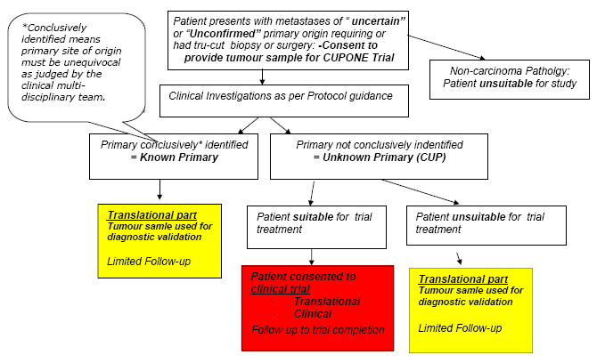
CUP ONE: Study Schema
Notes:
4

Slide 5
CUP-ONE Study Objectives
Primary objective:
- For translational part primary objective is to select the molecular classifier with the highest diagnostic accuracy
(expecting at least 50%% knowns)
- a) Immunohistochemistry (routine and and Algorithm driven- Oien)
b) RT-PCR-based gene expression (Bowtell – Tothill / Healthscope)
c) Microarray analysis for genome-wide expression ( site of origin classification -Biotheranostics)
- For the clinical trial the primary objective is to estimate the response rate with ECX (+/- biological)
Secondary objective: Both parts of Trial
- Progression-free survival (clinical)
- Overall survival
- Quality of life
- Cost utility comparison of diagnostic molecular classifiers with average clinical diagnostic work-up
- Correlation of molecular profiles with patient outcome
- To assess utility, relevance and necessity of clinical investigations in CUP, in comparison to molecular classifiers

Slide 6
CUP-ONE Trial has two parts: clinical and translational
Translational part of trial
  Uncertainty (at any-time of patient Pathway)
  Bx available- ‘split into 3’
  compares (double-blinded) –
    best currently available IHC tools at the highest standard
    Vs
    Modern molecular diagnostics
      Biotheranostics CancerTypeID
        V Healthscope CUPGuide Peter MacCallum Cancer Center (??)
  up to 400 patients assessable
  Erlander, M.G., et al., Molecular classification of carcinoma of unknown primary by gene expression profiling from formalin-fixed paraffin-embedded tissues. J Clin Oncol, 2004. 22(14S): p. 9545.
  Tothill, R.W., et al., An expression-based site of origin diagnostic method designed for clinical application to cancer of unknown origin. Cancer Res, 2005. 65(10): p. 4031-40
  Dennis, J.L., et al., Markers of adenocarcinoma characteristic of the site of origin: development of a diagnostic algorithm. Clin Cancer Res, 2005. 11(10): p. 3766-72.

Slide 7
CUP-ONE Trial has two parts: clinical and translational
Clinical part of trial (small subset)
  CUP by exclusion of known primary
  Phase II epirubicin, cisplatin, capecitabine
    20 patients : Futility / safety analysis
    56 patients : efficacy analysis
    off-trial Chemotherapy regimens & survival data
    - up to 400 patients assesable
    - Clinical – molecular predictive & prognostic correlates
    ? randomised Phase II –
      Vandetanib maintenance (AZ-NCRN) never happened

Slide 8
CUP ONE: Trial Recruitment in last 6 months before trial target accrual
Temp
stopped
futility analysis
Recuitment
> 600+
8-12 patients
/ month
Clinical
Translational

Slide 9
CUP ONE: Clinical Trial Recruitment
12 / 16 centres

Slide 10




Clinical outcomes from the UK CUP-ONE Study: A multi-centre trial to assess the efficacy of Epirubicin, Cisplatin and Capecitabine (ECX) in carcinomas of unknown primary (CUP) with prospective validation of molecular classifiers
CUP-ONE combines a multicentre phase II trial of an ongoing translational study [Part 1] incorporating blinded prospective validation of 3 diagnostic molecular classifiers, and treatment with epirubicin, cisplatin and capecitabine (ECX) [Part 2].
Recruitment: Since February 2010, CUP-ONE has recruited 592 patients to the Part 1 translational study (ongoing) and 59 to the clinical trial Part 2 (54 assessable in both parts). Part 2 closed to recruitment in February 2013. Results are presented for 58 eligible patients.
Study population: Male 47%, female 53%
ECOG PS 0: 38%, 1: 62%
Median age: 63 (range 29-78)
93% Stage IV, 5% Stage III
81% adenocarcinoma, 5% squamous carcinoma, 50% poorly/undifferentiated pathology
Treatment response (RECIST 1.1):
The best overall response rate was 35% (90% confidence interval 26%-46%), which rejects the null hypothesis of 20% (p=0.006).
The second evaluation demonstrates that additional continued responses are seen beyond 12 weeks in up to a quarter of patients.
Progression-free survival and overall survival
Median PFS is 30 weeks, 80% CI: (25 and 33 weeks)
Median OS is 44 weeks, 80 % CI: (30 and 48 weeks)

Slide 11
UK CUP-ONE: evolution of Clinical & research Framework
  Trial accrual Target 400 2014
  Trial accrual Target increased 2014
    Part 1 ECX clinical Phase II completed 2013
    Tissue QA guidance : IDMC 2014
      Extend Recruitment-
      624 final recuitment

Slide 12
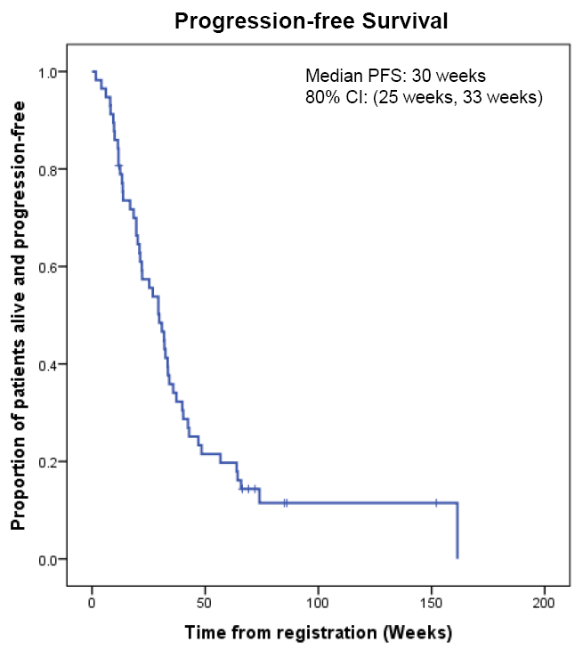
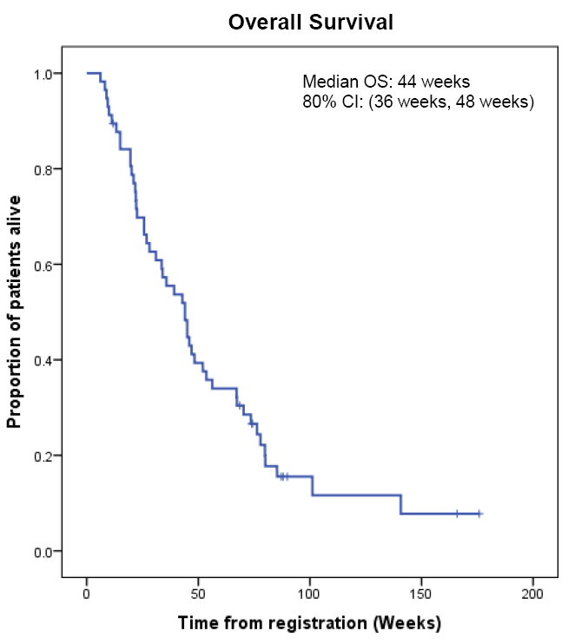
Efficacy & Response (RR 35%): CUP ONE Clinical Trial

Slide 13
Summary :UK UPDATE CUP RESEARCH
  UK CRUK NCRI CUP-ONE Trial
  ‘Best’ Tissue based test for site-of-origin
  Patient Outcomes (OS, predictive Biomarkers)
    Untreated
    Treated as site- specific
    Treated as CUP
    CUPEM
    NHSE CUP GECIP 100K Genome
      approved Q2 2017- Fresh Frozen
Notes:
Rapidly progressive nature and dismal prognosis of most patients with CUP, combined with the lack of standard regimes,
indicates that Novel therapeutic approaches are urgently needed
Biankin, A.V., Waddell, N., Kassahn, K.S., Gingras, M.C., Muthuswamy, L.B., Johns, A.L., Miller, D.K., Wilson, P.J., Patch, A.M., Wu, J., et al.; Australian Pancreatic Cancer Genome Initiative. (2012). Pancreatic cancer genomes reveal aberrations in axon guidance pathway genes. Nature 491, 399–405

Slide 14
CUPEM Phase II Trial
A Phase II, Two-Stage, Trial of Pembrolizumab in Cancer of unknown primary
Trial Type Single Arm, non-randomised; Two-stage; Hypothesis generating
Treatment Groups Two cohorts:
(i) First Cohort: One or more lines of prior therapy
(ii) Second Cohort: First Line untreated CUP patients
i) First Cohort: 20
ii) Second Cohort: 57
Imperial / RMH / GST

Slide 15
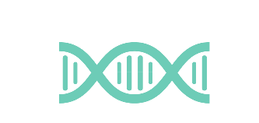
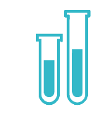

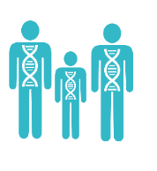
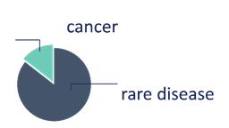
The 100,000 Genomes Project
Figures as at 11/01/2019
Samples
Genomes
Analysis and Results
118,489
56,622
103,311
Results for
Samples collected and received at the UK Biocentre
genomes sent to NHS GMCs
Genomes sequenced
Equivalent to
14,150
32,827
23,477
cancer genome analyses and 42,472 rare disease analyses
85,662
79,834
20-25% actionable findings for Rare Disease
~ 50% cancer cases contain potential for a therapy or a trial in our report
+2,962
genomes
since last month
Notes:
Latest samples collected > genomes > analysis and reports > actionable findings (from pilot phase)
Genomes sequenced number is published each month on the Genomics England website.

Slide 16
Diagnostic yield – pilot
Notes:
Mark to cover

Slide 17
Cancer challenging – re-engineer 300 pathology pathways
Identification of somatic small variants in 136 potentially actionable genes across all solid tumours (n=5700)
Cancer Programme
Molecular target → Targeted therapy
50% of 5700 patients have a known actionable or potentially actionable gene identified

Slide 18
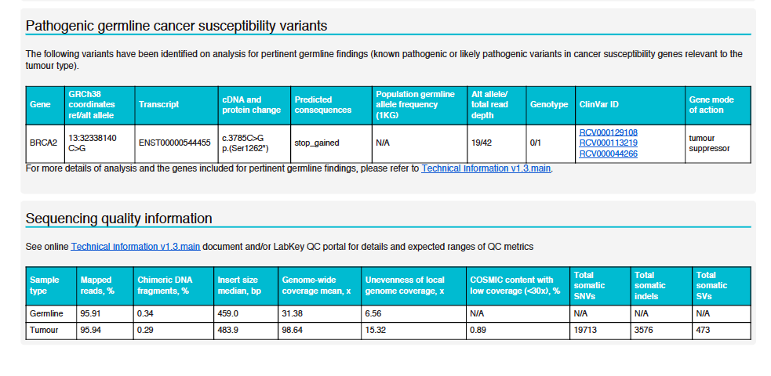
Pharmacogenetic germline variants
The following DPYD variants that confer susceptibility to severe toxicity when treated with 5-FU or capecitabine have been identified, in a screen for 10 established pharmacogenetic variants from the published Clinical Pharmacogenetics Implementation Consortium (CPIC) guideline (PMID: 29152729). Please refer to the Germline Pharmacogenetics Interpretation Document v1.1 for further details and interpretation of the results. The variants screened for are listed in the Technical information v1.9.
PharmGKB ID
PA166171125
DPYD
chr1:97450058
ENST00000370192.7
c.1905+1G>A
No Function
0.004
29/30
27/30
PA166171117
DPYD
chr1:97883352
ENST00000370192.7
c.1156G>T
No Function
0.00008
PA166171125

Slide 19

Facilitating recruitment of patients to clinical trials
FOCUS-4 Trial
229 colorectal cancer patients were identified with mutations which could be eligible for FOCUS4 trial, if they were to develop a recurrence

Slide 20
CUP-ONE Study Team
CR-UK CTU (Glasgow)
  Chief Investigator: Harpreet Wasan
  Translational Pathology lead Karin Oien
  Trial Statistician: Jim Paul
  Project Management: Lynn McMahon;
  Pharmacovigilance: Lindsey Connery; Katie Nocher
  Quality Assurance: Lindsey Connery
  Trial Co-ordinators: Pamela Fergusson; Robina Ullah; Linda Stevens; Elaine McCartney; Elizabeth Douglas; Eileen Smillie; Samantha Carmichael; Deepthi Beeravelli
TMG Marianne Nicolson; David Bowtell; Mark Erlander; Jeff Evans; Hani Gabra, Jayson Wang

Slide 21
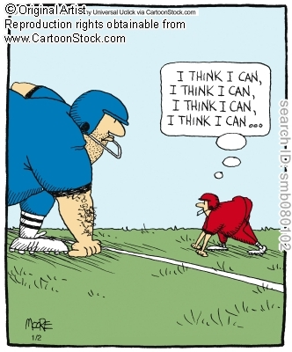
CUP ONE Trial evolution…..
…….. Japan Vs South Africa !

Slide 22
Cancer of Unknown Primary (CUP):
Thank you
Dr. Harpreet S. Wasan
Department of Cancer Medicine
Hammersmith Hospital / Imperial College London wasan@cancer.org.uk
OCT 2009

