Slide 1
Talk outline
Brief history of gene-expression profiling for cancer type classification
Current commercially available tests - development and performance
Clinical application
Problems and limitations
How DNA sequencing and mutation profiling can potentially help

Slide 2
Talk outline
Brief history of gene-expression profiling for cancer type classification
Current commercially available tests - development and performance
Clinical application
Problems and limitations
How DNA sequencing and mutation profiling can potentially help

Slide 3
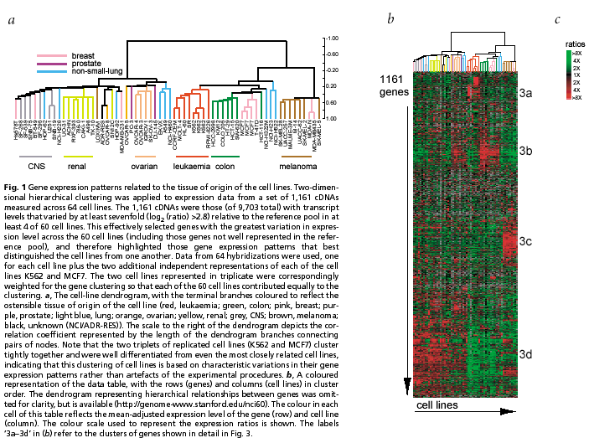
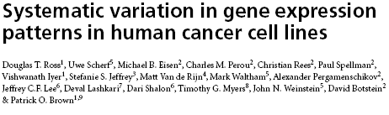
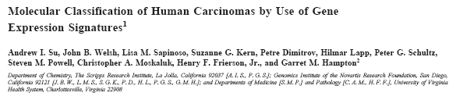
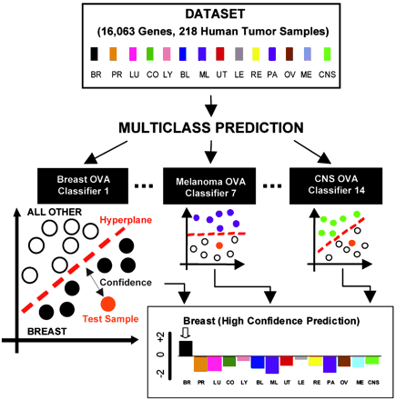
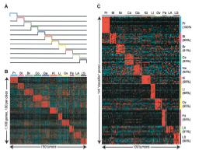

History of tissue of origin gene-expression classification
Ross et al 2000 Nat. Genet
Su et al 2001 Cancer Research
Ramaswamy et al 2001 PNAS

Slide 4
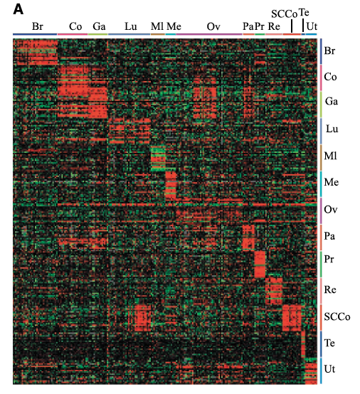
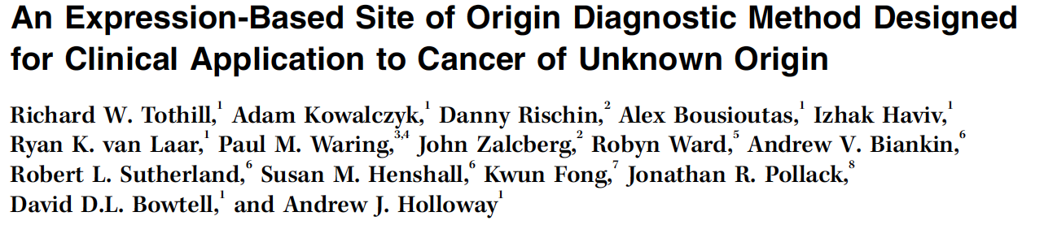
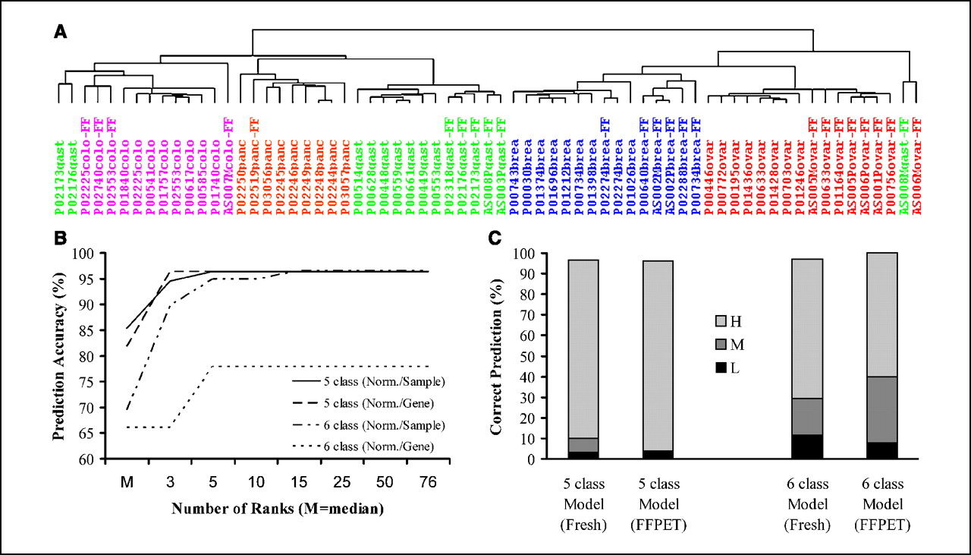
First translation of gene-expression classifier to CUP
Tothill et al Cancer Res. 2005 65:10
229 specimens
14 tumour sites
25 histological and molecular subtypes
SVM Classification accuracy LOOCV
(known origin): 89%
Applied to 13 CUP cases
11/13 cases could be predicted
supported by clinical data
Translation to RT-PCR enables use of FFPE samples
Notes:
In the days before next generation sequencing the focus was on using microarray gene-expression profiling to identify potential tissue of origin.

Slide 5
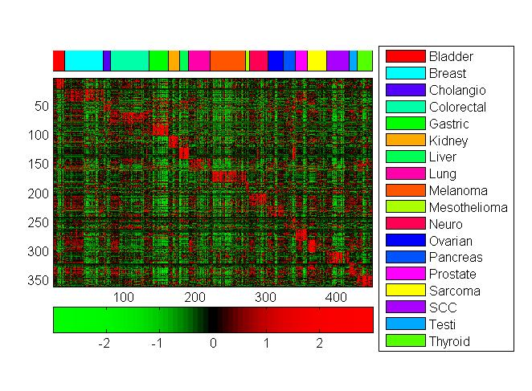
CUPGuide diagnostic CUP TOO test
Histology guided GEP assay
Illumina DASL Arrays
Training set : n= 450 18 cancer types
All FFPE, majority (57%) mets
Validation set n=94
Accuracy: 88% (97% top two)
Latent CUP primary validation: 78%
Tothill et al 2015, Pathology 47: 7-12
Notes:
Major limitation to original work was that it was not compatible with FFPE tissue and did not include some cancer types
Development of new test in collaboration with Healthscope

Slide 6
Talk outline
Brief history of gene-expression profiling for cancer type classification
Current commercially available tests - development and performance
Clinical application
Problems and limitations
How DNA sequencing and mutation profiling can potentially help

Slide 7
Other commercial GEP ToO tests and clinical utility
BioTheranostics CancerTypeID (https://www.cancertypeid.com/) $US 3,600
92 gene RT-PCR test, 30 tumour types, 50 subtypes
(Ma et al 2006; Erlander et al 2011)
Cancer Type (formerly Pathworks) (http://www.cancergenetics.com) $USD 3250
(FDA Approved)
Microarray (Affymetrix), 15 cancer types, 1550- 2000 genes
(Monzon et al 2009,2010, Pillai et al 2011)
Rosetta Tissue of Origin Test (recently discontinued)
64 microRNAs array, 42 tumor origins
(Rosenwald et et al 2010, Mei et al 2012)

Slide 8
BioTheranostics CancerTypeID
BioTheranostics CancerTypeID (https://www.cancertypeid.com/)
Design: 92 gene (87 + 5 controls) RT-PCR test, kNN, 30 tumour types, 50 subtypes
Development
- Version 1 (Ma et al 2006) Arcturus dataset also used by Agendia CUPPrint)
Version 2 (Erlander et al 2011 ) Expanded training set (2,206 samples)
Validation and performance on known primaries
1st reported accuracy (Version 2) Test set: 83% (Erlander et al 2011)
Multi-site validation (US) (n=790) Type, 87%; subtype, 83%; primary, 88%; mets, 85% (Kerr et al 2012)
Chinese study (n=184), sensitivity: primary 86.3%, mets 73%. (Katoh et al 2012)
Superior in blinded comparison to IHC (GEP: 79%, IHC: 69% mean 7.9 stains) (Weiss et al 2013)
Poorly differentiated neoplasms (epithelial and non-epithelial)(=30)(Greco et al 2015)
- 83% supported by IHC and genotyping
Application to NETs of unknown primary (Kerr et al 2014, Chauhan et al 2019)

Slide 9
Other commercial GEP ToO tests and clinical utility
BioTheranostics CancerTypeID (https://www.cancertypeid.com/) $US 3,600
92 gene RT-PCR test, 30 tumour types, 50 subtypes
(Ma et al 2006; Erlander et al 2011)
Cancer Type (formerly Pathworks) (http://www.cancergenetics.com) $USD 3250
(FDA Approved)
Microarray (Affymetrix), 15 cancer types, 1550- 2000 genes
(Monzon et al 2009,2010, Pillai et al 2011)
Rosetta Tissue of Origin Test (recently discontinued)
64 microRNAs array, 42 tumor origins
(Rosenwald et et al 2010, Mei et al 2012)

Slide 10
Cancer Type (formerly Pathworks)
Cancer Type (formerly Pathworks) (http://www.cancergenetics.com)
Design
- Microarray gene test (Affymetrix), 15 cancer types, 1550- 2000 genes, FDA Approved.
Development
Version 1 Fresh tissues (n=547) (Dumur et al 2008, Monzon et al 2009),
Version 2 FFPE samples (Training n=2136) (Pillai et al 2011)
ToO Endometrial (Ovarian vs uterine) (Lal et al 2012)
ToO SCC Version (H&N vs Lung) (Lal et al 2013)
Validation and performance (Pillai et al 2011)
1st reported accuracy (Version 2) , Test set (n=462) (primary and mets): 87.8%
Superior to 2-round IHC (Handorf et al 2015)
Test set (n=157)
GEP: 89%, IHC: 83%, Poorly diff. tumours (GEP: 83%, IHC: 67%)

Slide 11
Talk outline
Brief history of gene-expression profiling for cancer type classification
Current commercially available tests - development and performance
Clinical application
Problems and limitations
How DNA sequencing and mutation profiling can potentially help

Slide 12
Testing on CUP – latent primary, IHC and other
BioTheranostics CancerTypeID
Agreement with conventional tests (n=171) (Greco et al 2013)
Latent primary (n=24): 75%
With single origin IHC (n=52): 77%
Agreement with GEP led IHC (n=35): 74%
Clinical picture: 70%
Cancer Type (formerly Pathworks)
Accuracy for CUP (n=21) 72% clear prediction
Supported by clinicopath. data: 62% (Monzon et al 2010)
“Tumours of uncertain origin”: (n=284). (Laouri et al 2011)
- Changed non-specific to specific/changed leading diagnosis 81% cases
- Confirmed diagnosis in 15 cases

Slide 13
Is there any survival benefit?
BioTheranostics CancerTypeID
Improved survival with ToO directed therapy (n=289) Sarah Cannon Cancer Centre (Hainsworth et al 2013)
- 252/289 patients tested and 249 ToO prediction made
- 223 patients therapy candidate, 194 received for site specific therapy
- Improved survival over historical data 12.5 months (95% CI, 9.1 to 15.4 months) vs 8-11 months (Hx.)
- Better survival in more responsive cancer types 13.4 v 7.6 months
- Better survival in high probability predictions (n=95) 12.5 vs 10.8 months (n=99)
CancerType (formerly Pathworks)
Multi-centre study (n=107) (Nystrom et al 2012).
- Changed working diagnosis in 50% and patient management in 65%
- Guideline directed therapy: Median survival 14 months.
Improved outcome in platinum responsive tumour types (n=38) (Yoon et al 2016)
Platinum sensitive types (LU, OV, BL, BR) (n=19) versus platinum resistant types (n=19)
ORR (53% vs 26%) PFS (6.4 versus 3.5 months) and OS (17.8 versus 8.3 months, P = 0.005)

