Slide 1
CUP patient pathway with CUP team & MDT
NICE guidelines mandated CUP networks across hospitals
CUP team in each hospital with cancer care
Link with acute oncology
CUP specialist nurse or keyworker
Major role in coordinating patient's care
CUP network multidisciplinary team (MDT) including pathologist set up to review treatment and care of patients with confirmed CUP
Provide clinical management & support like type- and site-specific cancer MDTs
Avoid “MDT tennis”
Notes:
At least two slides and describe difference this has made incl. questions:
Acute oncology as specialty and CUP as subspecialty within that
MDT approach incl. virtual MDT
Challenges of when patients enter CUP pathway and how and when to review them as MDT: real or virtual

Slide 2
“Favourable” / “good prognosis” CUPs more defined and going to site-specific MDTs
Consolidation of “good prognosis” subsets: 20-30%
Outcome and treatment as for similar stage with known cancer (Pavlidis & Pentheroudakis; Greco)
ESMO (European Society Medical Oncology), Fizazi et al 2015
Notes:
Check this doesn’t duplicate other slides about good prognosis

Slide 3
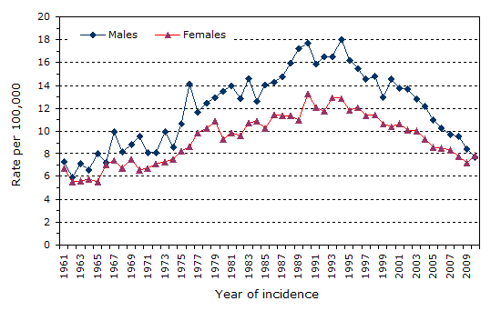
With these approaches, CUP incidence, which had increased, is now decreasing
Brewster (2014). Cancer Epidemiology.

Slide 4
Outline
Cancer of Unknown Primary
Pathology classification for cancer in general and CUP in particular including immunohistochemistry (IHC) (morphomolecular part 1)
Performance & practice
RCPath dataset
CUP management through MDT approach
Morphomolecular approaches beyond IHC (part 2)
What is CUP today - MUO through to provisional CUP, confirmed CUP - “residual CUP”?
Main challenges in pathology esp. “residual CUP” and therefore unmet needs
Approaches, implementation and next steps

Slide 5
CUP teams managing residual “unfavourable” or “poor prognosis” CUP
Residual “poor prognosis” CUP pathology is mainly:
Poorly differentiated tumour, or
Adenocarcinoma without obvious primary site, often positive for CK7 but not much else
Notes:
“Residual CUP” poor prognosis
Pathology of “residual CUP”? Mainly either poorly differentiated “high-grade horrible” or adenocarcinoma without obvious primary site esp. CK7+, not much else positive. Here straight into CUP pathology?? Let’s go…
CUP clinical/epidemiology: good prognosis subgroups out, left mainly with poor prognosis rump of adeno or poorly diff. (CUP trials not commonly experience with small cell CUP)
Somewhere quotes from CUP patients and relatives

Slide 6
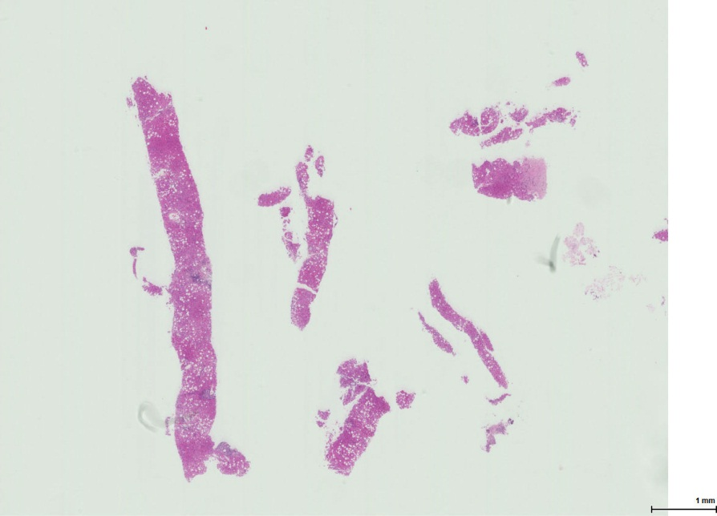
Diagnostic difficulties: not enough tissue
After morphology, with IHC if needed, common diagnostic difficulties in classical tumour typing are with:
Limited viable tissue
Small samples especially if further testing requested at end of pathology processes
Necrotic samples
Unmet clinical need to address
Notes:
Adenoca and poorly diff often grouped together and make up 90%

Slide 7
Diagnostic difficulties: difficult morphology
Common diagnostic difficulties in classical tumour typing for CUP are with:
“Very poorly differentiated or undifferentiated tumours
Adenocarcinoma, even well-differentiated, without obvious primary site
Pancreatico-biliary including cholangiocarcinoma
Gastro-oesophageal
Ovarian mucinous
Atypical tumours from lung, breast etc
Unmet clinical need to address
Notes:
Adenoca and poorly diff often grouped together and make up 90%

Slide 8
Biomarker challenges
Classic biomarkers for primary site are highly specific (at top of ranking and decision trees)
Specific biomarkers for stomach & pancreas are lacking
Marker | Tumours of | % Sensitivity | % Specificity
PSA | Prostate | 100 | 99
TTF1 | Lung | 91 | 98
CDX2 | Colon | 83 | 96
CDX2 | Colon and stomach | 56 | 98
CK20 | Colon | 68 | 91
CK20 | Colon, stomach and pancreas | 36 | 97
GCDFP-15 | Breast | 54 | 96
ER | Breast and ovary | 74 | 95
CA125 | Ovary and pancreas | 88 | 88
Mesothelin | Ovary and pancreas | 85 | 85
Lysozyme | Stomach and pancreas | 65 | 69
CK7 | (Stomach and pancreas) versus colon | 72 | 96
Based on Dennis, lin Cancer Res 2005; 11(10):3766-3772.

Slide 9
Diagnostic difficulties: difficult immunohistochemistry
IHC is subjective: technical performance and microscopic interpretation varies (as does actual tissue expression), so IHC biomarkers used in panels
IHC is selective: often limited tissue & time so only few biomarkers can be tested (study showed 7-8 was usual in CUP)
In CUP, a barrier to correct tumour classification is not using the most appropriate markers
Image from Wellcome Images; Weiss et al 2012, Schroeder et al 2012
Notes:
Tumour heterogeneity

Slide 10
Can we quantify performance of current pathology in CUP classification?
5-6 studies identified in meta-analysis
(Difficult to study by definition)
Sensitivity of IHC panels for primary site was consistent, around 82% in mixed primary and metastatic tumours and 66-70% in metastases alone
Confirms metastases are harder to classify than primary tumours by IHC
Sets baseline for comparisons with molecular tests
Anderson et al 2010, Weiss et al 2012, Sanden et al 2012
Notes:
Adenoca and poorly diff often grouped together and make up 90%

Slide 11
Molecular profiling in CUP
Large-scale profiling for CUP has been achieved at mRNA, miRNA, DNA and epigenetic levels
Molecular profiling for primary site: esp. mRNA/miRNA; also epigenetic
Adds to existing classifications?
Commercial tests
Molecular analysis for mutations especially “actionable targets”
May suggest primary site
But mainly for therapeutic prediction
Adds to or new classification/taxonomy
Image from Royal College of Pathologists; Pillai et al 2011, Stancel et al 2012, Erlander et al 2011, Meiri et al 2012; reviewed in Oien 2012 Ann Oncol; Moran 2016 Lancet Oncology
Notes:
Basis is that different tissue types have distinct RNA profiles

Slide 12
Molecular profiling for primary site: rationale
“Different tissue types have distinct RNA profiles” (…or epigenetic, or protein…etc)
Yield tumour type, site and/or subtype i.e. classic taxonomy
IHC and mRNA molecular profiling use similar tissue-specific genes:
Molecular profiling tests more genes and may be less subjective
Greco 2014, Pillai et al 2011, Stancel et al 2012, Erlander et al 2011, Meiri et al 2012, Oien 2012
Notes:
Basis is that different tissue types have distinct RNA profiles

Slide 13
Three CUP RNA tests commercially available
And EpiCUP based on epigenetics
Tissue of Origin (TOO) test (Response Genetics, previously PathWorks Diagnostics)
Cancer Type ID (CTID)
(bio-Theranostics)
miRview mets2 (Rosetta Genomics)
http://rosettagenomics.com/
http://www.responsegenetics.com/products-services/tissue-of-origin-testing/
Notes:
Complete cell and tissue definitions

Slide 14
Molecular profiling for primary site: results
“Clinical accuracy of all three tests is similar: 85-88%. Test accuracy in CUP cases not easily determined, because origin not identified in most cases.”
10% of RNA tests yield no result
Tumours difficult for morphology and IHC often also difficult for molecular profiling
In poorly differentiated tumours, molecular profiling may:
Yield likely final diagnosis in 78-92%
Compared with 68-70% for IHC
Thus out-perform IHC by 10-20%
Greco 2015 Mol Diagn Ther, Weiss et al 2012, Sanden et al 2012
Notes:
Genes: e.g. CDX2, PAX8, PSA and S100
Difficult tumours e.g. undiff or panc ca.

Slide 15
Guidelines and health economics in CUP profiling tests
NCCN Recommendations 2014
NCCN Recommendations 2015
US NCCN Clinical Practice Guidelines on Occult Primary: Although GEP (Gene Expression Profiling) has a diagnostic benefit, clinical benefit has not been demonstrated. The panel recommends against GEP as standard management…
US NCCN Clinical Practice Guidelines on Occult Primary: Until more robust outcomes and comparative effectiveness data are available, pathologists & oncologists must collaborate on the judicious use of these modalities (IHC and GEP) on a case-by-case basis, with the best possible individualized patient outcome in mind.
Elsewhere: is testing cost-effective?
In models: yes if influences survival.
For healthcare: may save work-up costs but may bring in additional oncology costs
Molecular profiling not currently recommended in NICE or ESMO guidelines
FDA approved and used in USA
https://www.nccn.org/professionals/physician_gls/f_guidelines.asp http://www.ncbi.nlm.nih.gov/pubmedhealth/PMH0073073/pdf/TOC.pdf/ Hannouf 2016 Pharmacogenomics Journal, Prasad 2015 Eur J Cancer

Slide 16
Where from, where going and how getting there?
Where from? RNA etc for tissue of origin
Notes:
Pathology: actionable mutations and aetiological mutations. Return to considering possible markers: markers of tissue of origin akin to IHC (where from); markers of carcinogenic mechanism (route); actionable mutations (where going). Consider e.g. picture of Harry Potter train and bridge.

Slide 17
Where from, where going and how getting there?
Where from? RNA etc for tissue of origin
Where going to? “Actionable” mutations
Notes:
Pathology: actionable mutations and aetiological mutations. Return to considering possible markers: markers of tissue of origin akin to IHC (where from); markers of carcinogenic mechanism (route); actionable mutations (where going). Consider e.g. picture of Harry Potter train and bridge.

Slide 18
Where from, where going and how getting there?
Where from? RNA etc for tissue of origin
How getting there? Mutation spectrum in carcinogenesis
Where going to? “Actionable” mutations
Notes:
Pathology: actionable mutations and aetiological mutations. Return to considering possible markers: markers of tissue of origin akin to IHC (where from); markers of carcinogenic mechanism (route); actionable mutations (where going). Consider e.g. picture of Harry Potter train and bridge.

Slide 19
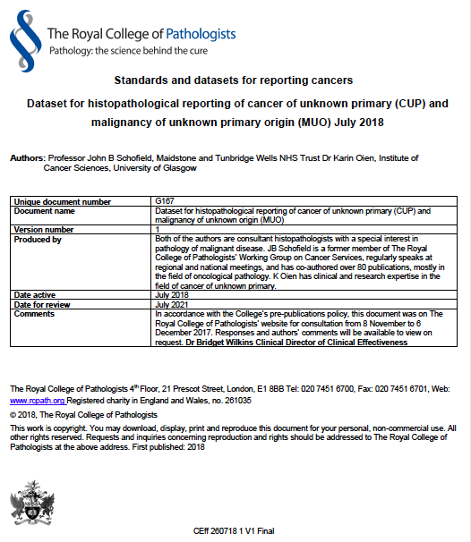

Slide 20
CUP definitions with MDT approach
Malignancy of undefined primary origin (MUO) | Metastatic malignancy identified on the basis of a limited number of tests, without an obvious primary site, before comprehensive investigation.
Provisional carcinoma of unknown primary origin (provisional CUP) | Metastatic epithelial or neuro-endocrine malignancy identified on the basis of histology or cytology, with no primary site detected despite a selected initial screen of investigations, before specialist review and possible further specialised investigations.
Confirmed carcinoma of unknown primary origin (confirmed CUP) | Metastatic epithelial or neuro-endocrine malignancy identified on the basis of final histology, with no primary site detected despite a selected initial screen of investigations, specialist review, and further specialised investigations as appropriate.
Malignancy of undefined primary origin (MUO)
Provisional CUP
Confirmed CUP
More
cancers of
known type & origin
NICE guidance/guideline on CUP, 2010 https://www.nice.org.uk/guidance/cg104/resources/metastatic-malignant-disease-of-unknown-primary-origin-diagnosis-and-management-of-metastatic-malignant-disease-of-unknown-primary-origin-35109328970437
Notes:
Consider ESMO and other definitions

Slide 21
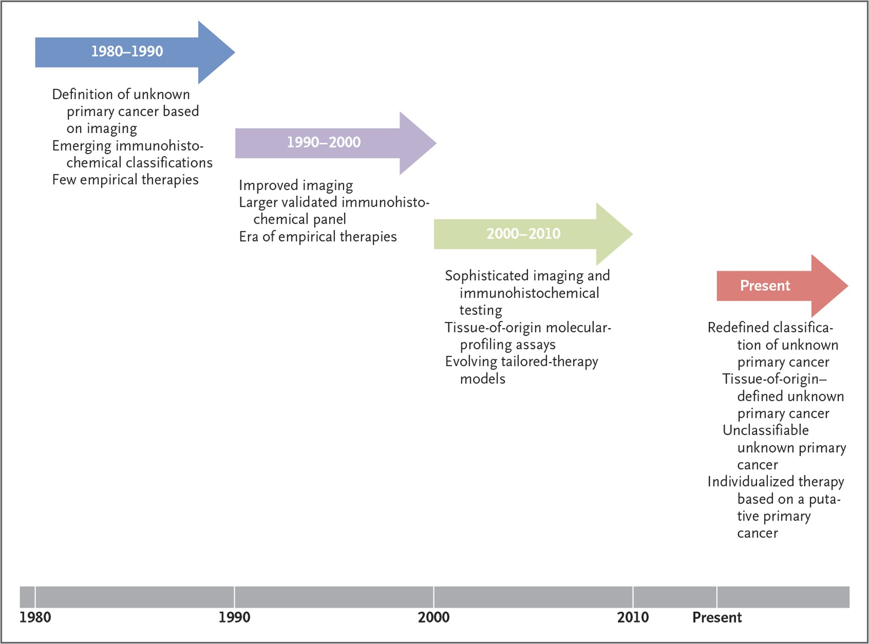
Summary of CUP Past, Present, Future Classification of CUP through the Decades
Notes:
Figure 1 Classification of Unknown Primary Cancer through the Decades. Over the years, we have seen an improvement in diagnostic methods, including imaging, pathological testing, and molecular markers. These advances have helped define the current taxonomy of unknown primary cancer.

Slide 22
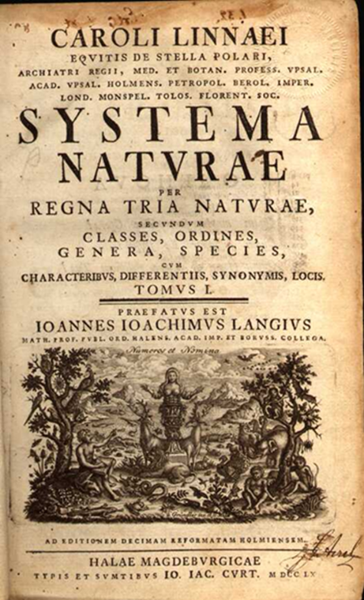
Conclusions: Pathology incl. IHC in CUP
Pathology, with IHC if needed, remains “gold standard” in tumour classification, especially where:
Tumour has obvious likely primary and/or
Tumour is at least moderately differentiated and/or
IHC results are classical and/or
The clinical context is appropriate
Optimal pathology enabled by:
Standardised approach incl. IHC
MDT approach to enable full clinical context and knowledge of potential treatments
Notes:
IHC guidelines: for technical approach and potential panels to use

Slide 23
Conclusions: CUP pathology unmet needs and morpho-molecular approaches
Adenocarcinomas without obvious primary & poorly differentiated cancers, esp. if:
Current pathology equivocal for management or conflicting with clinical context
Diagnosis either truly unknown or includes multiple possible differentials
Limited tissue or time?
Better prediction of treatment benefit
Molecular profiling and screening for actionable mutations provide additional information, often potentially clinically significant incl. treatment guidance, but not yet included in most guidelines
How best to use? And how to evidence towards funding and implementation of:
Molecular classifiers for site/type
Molecular analysis for actionable mutations
Complementary & in clinicopathological context
Notes:
Not in necrotic tumour

Slide 24
Acknowledgements
Personal thanks to:
Dr Jayne Dennis
Dr Harpreet Wasan &Jayson Wang
Prof David Bowtell and colleagues
Colleagues in BioTheranostics
Prof Nicol Keith
Prof Jeff Evans
Profs Andrew Biankin & Sean Grimmond and colleagues
Personal thanks to Cancer Research UK and University of Glasgow for funding; but this presentation is my personal opinion
CUP Heroes
Pathology Heroes
John Symons & Jo’s Friends
Profs John Schofield, Paul Barrett and colleagues
Notes:
Karim Fizazi
Tony Greco
Nicholas Pavlidis
George Pentheroudakis
Gauri Varadhachary
John Symons
Richard Osborne
John Bridgewater
Harpreet Wasan
David Bowtell
Cathy Schnabel
Kari Hemminki
And all CUP colleagues too many to fully mention here

