Slide 1
Opening remarks
Welcome to CUP 2019: Cancer of Unknown Primary in the Era of Precision Medicine
Focus: Contemporary Clinical Management and International CUP Research

Slide 2
Opening remarks… continued
Objectives:
  Current Optimal Tissue Diagnostics
  Clinical and Translational Trials
  Optimal Clinical Management and Focus on the Future
  Debate Controversies Regarding Biology, Diagnosis and Treatment

Slide 3
Many Different cancers present as cup
The CUP Syndrome is unique and appears to be a small subset of many specific cancer types with very small anatomical primary sites, but with ability to metastasize
The explanation of why the small invasive primary does not grow large and why metastasis develop and grow remains unknown, but likely a genetic/epigenetic mechanism.

Slide 4
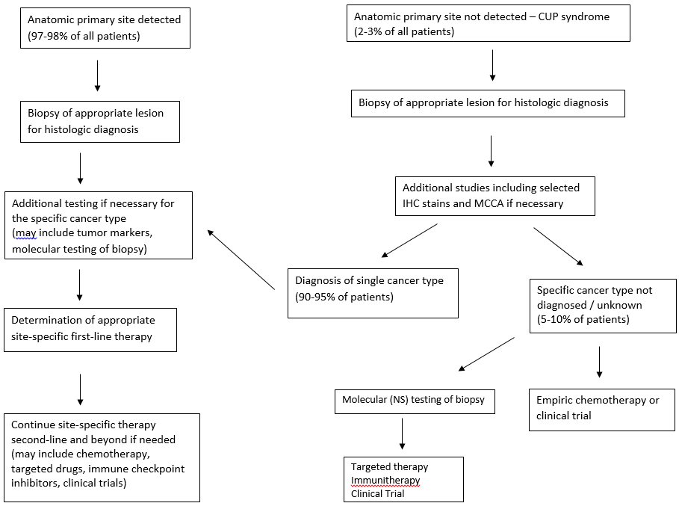
Management of patients with metastatic cancer

Slide 5
A New initiative: precision medicine defined
The Prevention and Treatment of Patients
Based on Individual Variability
Collins and Varmus, NEJM 2015

Slide 6
Precision oncology: Not So new after all but expanding rapidly
Breast Cancer Hormone Receptor, HER2, BRCA Status
GEJ Cancer HER2 Status
CRC KRAS Status
HN Cancer HPV Status Guides Treatment
Ovarian Cancer BRCA Status Guides Treatment
CML BCR-ABL Status Guides Treatment
AML Cytogenetics Guide Treatment
NHL FISH Status Guides Treatment
Lung Cancer EGFR, ALK/ROS 1 Guides Treatment

Slide 7
A Case for rapid change: Lung cancer care
EGFR
2004
Erlotinib
2015
Osimertinib
Histology
2006
Bevacizumab
ALK
2011
Crizotinib
2014
Ceritinib
2015
Alectinib
2017
Brigatinib
2018
Lorlatinib
ROS
PDL1, BRAF, MSI, HER2, RET, NTRK, TMB?
2016
Crizotinib
2016
Pembrolizumab (PD-L1+)
2017
Dabrafenib, Tramectinib
Pembrolizumab (MSI, +chemo)
2018
Larotrectinib
2007
Pemetrexed

Slide 8
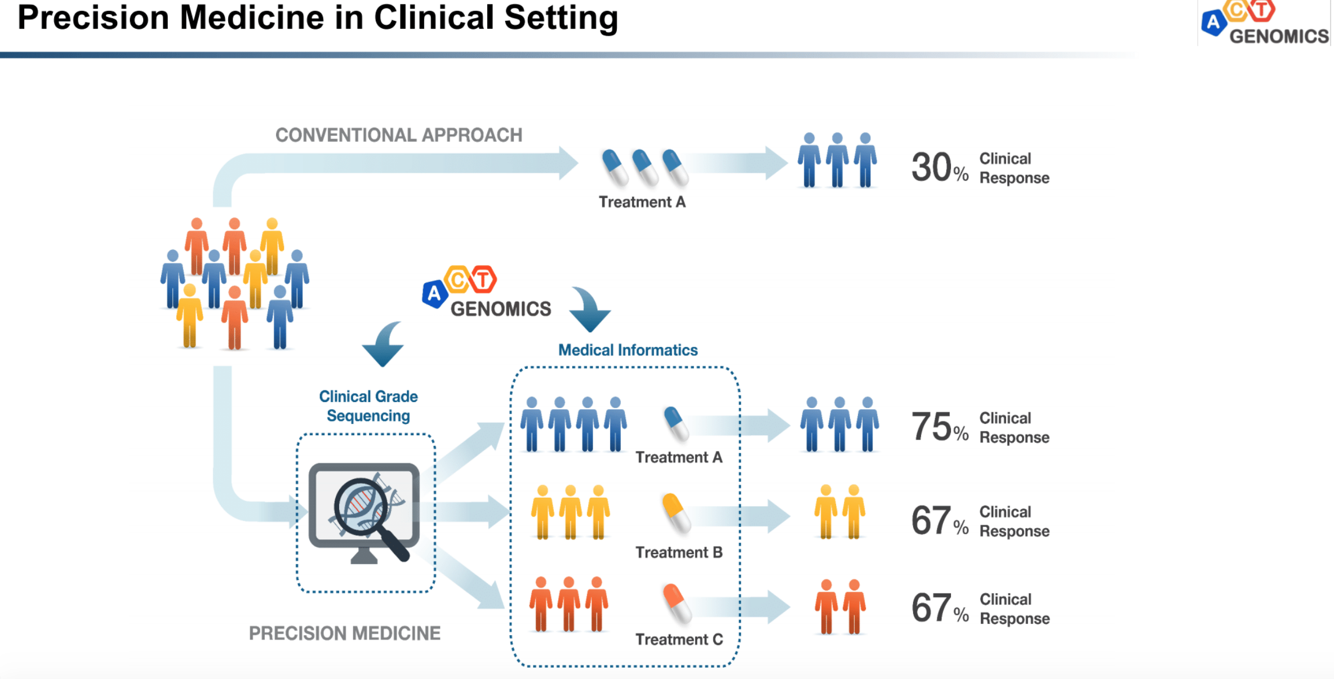
Precision medicine
DATA
Notes:
the right drug at the right dose to the right patient

Slide 9
MAJOR QUESTIONS
Is CUP a Single Entity With a Unique Biology?
Does the Diagnosis of the Tissue of Origin and Site-Specific Therapy Improve Patient Outcomes?
Does Comprehensive Molecular Profiling (NGS) of the Biopsy Specimen Provide Information for Precision Therapy?
Does Empiric Chemotherapy (one therapy for CUP patients) Still Have a Role?
Yes and No!
Yes and No!
Yes and No!
Yes and No!

